Slide 1
UNIT II: Random Variables and Mathematical expectation

Slide 2
UNIT II: Random Variables and Mathematical expectation
Random variable, Discrete Random Variable, Continuous Random Variable, Mathematical Expectation, Addition theorem of Expectation, Multiplication theorem of Expectation, Chebychev's Inequality

Slide 3
Random Variable
A random variable is a variable whose value is unknown or a function that assigns values to each of an experiment's outcomes.
The use of random variables is most common in probability and statistics, where they are used to quantify outcomes of random occurrences.
Risk analysts use random variables to estimate the probability of an adverse event occurring

Slide 4
Understanding a Random Variable
In probability and statistics, random variables are used to quantify outcomes of a random occurrence, and therefore, can take on many values.
Random variables are required to be measurable and are typically real numbers.
For example, the letter X may be designated to represent the sum of the resulting numbers after three dice are rolled. In this case, X could be 3 (1 + 1+ 1), 18 (6 + 6 + 6), or somewhere between 3 and 18, since the highest number of a die is 6 and the lowest number is 1.

Slide 5
Understanding a Random Variable
A random variable is different from an algebraic variable. The variable in an algebraic equation is an unknown value that can be calculated. The equation 10 + x = 13 shows that we can calculate the specific value for x which is 3. On the other hand, a random variable has a set of values, and any of those values could be the resulting outcome as seen in the example of the dice above.
In the corporate world, random variables can be assigned to properties such as the average price of an asset over a given time period, the return on investment after a specified number of years, the estimated turnover rate at a company within the following six months, etc.

Slide 6
Types of Random Variables
A random variables are of two types
Discrete (having specific values)
Continuous (any value in a continuous range)

Slide 7
Discrete Random Variables
Discrete random variables take on a countable number of distinct values.
Consider an experiment where a coin is tossed three times. If X represents the number of times that the coin comes up heads, then X is a discrete random variable that can only have the values 0, 1, 2, or 3 (from no heads in three successive coin tosses to all heads). No other value is possible for X.

Slide 8
Continuous Random Variables
Continuous random variables can represent any value within a specified range or interval and can take on an infinite number of possible values.
An example of a continuous random variable would be an experiment that involves measuring the amount of rainfall in a city over a year or the average height of a random group of 25 people.
Drawing on the latter, if Y represents the random variable for the average height of a random group of 25 people, you will find that the resulting outcome is a continuous figure since height may be 5 ft or 5.01 ft or 5.0001 ft. Clearly, there is an infinite number of possible values for height.

Slide 9
Mathematical Expectation
Mathematical expectation, also known as the expected value, which is the summation of all possible values from a random variable.
It is also known as the product of the probability of an event occurring, denoted by P(x), and the value corresponding with the actually observed occurrence of the event.
For a random variable expected value is a useful property. E(X) is the expected value and can be computed by the summation of the overall distinct values that is the random variable.
The mathematical expectation is denoted by the formula:
E(X)= Σ (x₁p₁, x₂p₂, …, x_{n}p_{n}),
where, x is a random variable with the probability function, f(x),
p is the probability of the occurrence,
and n is the number of all possible values.

Slide 10
Mathematical Expectation
The mathematical expectation of an indicator variable can be 0 if there is no occurrence of an event A, and the mathematical expectation of an indicator variable can be 1 if there is an occurrence of an event A.
For example, a dice is thrown, the set of possible outcomes is { 1,2,3,4,5,6} and each of this outcome has the same probability 1/6. Thus, the expected value of the experiment will be 1/6*(1+2+3+4+5+6) = 21/6 = 3.5.
It is important to know that “expected value” is not the same as “most probable value” and, it is not necessary that it will be one of the probable values.

Slide 11
Properties of Expectation
If X and Y are the two variables, then the mathematical expectation of the sum of the two variables is equal to the sum of the mathematical expectation of X and the mathematical expectation of Y.
E(X+Y)=E(X)+E(Y)
The mathematical expectation of the product of the two random variables will be the product of the mathematical expectation of those two variables, but the condition is that the two variables are independent in nature. In other words, the mathematical expectation of the product of the n number of independent random variables is equal to the product of the mathematical expectation of the n independent random variables
E(XY)=E(X)E(Y)

Slide 12
Properties of Expectation
The mathematical expectation of the sum of a constant and the function of a random variable is equal to the sum of the constant and the mathematical expectation of the function of that random variable.
E(a+f(X))=a+E(f(X)),
where, a is a constant and f(X) is the function.
The mathematical expectation of the sum of product between a constant and function of a random variable and the other constant is equal to the sum of the product of the constant and the mathematical expectation of the function of that random variable and the other constant.
E(aX+b)=aE(X)+b,
where, a and b are constants.

Slide 13
Properties of Expectation
The mathematical expectation of a linear combination of the random variables and constant is equal to the sum of the product of ‘n’ constant and the mathematical expectation of the ‘n’ number of variables.
E(∑a_{i}X_{i})=∑ a_{i} E(X_{i})
Where, a_{i}, (i=1…n) are constants.

Slide 14
Example on Mathematical Expectation
Q. What is the expected number of coin flips for getting two consecutive heads?
Sol: Let the expected number of coin flips be x.
If the first flip is a tail then the probability of the event is 1/2. Thus, the total number of flips required is x+1. If the first flip is a head and the second flip is a tail, then the probability of the event is 1/4 and the total number of flips we require is x+2. If the first flip is a head and the second flip is also heads, then the probability of the event is 1/4 and the total number of flips we require is 2. By Adding, the equations we get
x = (1/2)(x+1) + (1/4)(x+2) + (1/4)2
By solving the equation, x = 6.
So, the expected number of coin flips for getting two consecutive heads is 6

Slide 15

Addition Theorem on Expectations
If X and Y are two discrete random variables then
E(X+Y) = E(X) + E(Y)
Proof-Let X and Y be two discrete random variables with their joint/bivariate probability distribution P(x, y) = P[x = x, y = y] and, The probability distribution of X and Y are-

Slide 16
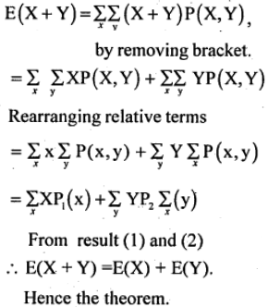
Addition Theorem on Expectations
by the definition of mathematical expectations

Slide 17
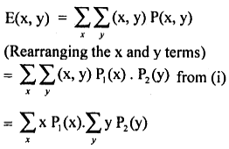
Multiplication Theorem of Expectation
Let x and y be two independent discrete random variables with respective expectations E(x) and E(y). then the expectation of the product of these random variables is: E(xy) = E(x) . E(y)
Proof: Let x and y be two independent discrete random variables, then joint probability function P(x, y) is P(x, y) = P1(x). P2(y) ……(i)
Then, by the definition of mathematical expectation
From the definition mathematical expectation E(x y) = E(x) . E(y)

Slide 18
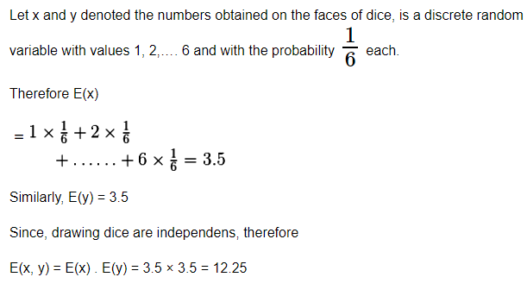
Example-A bag has ten tiny of dice. Two dice are randomly drawn. Find the expectation of the product of the numbers obtained on the faces of dice

